Slide 1
Large and Fast: Exploiting Memory Hierarchy
Dr R. R. Maiti
CSIS, BITS-Pilani, Hyderabad

Slide 2
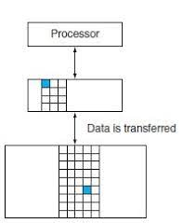
the minimum unit of information that can be either present or not present in the two-level hierarchy is called a block or a line

Slide 3
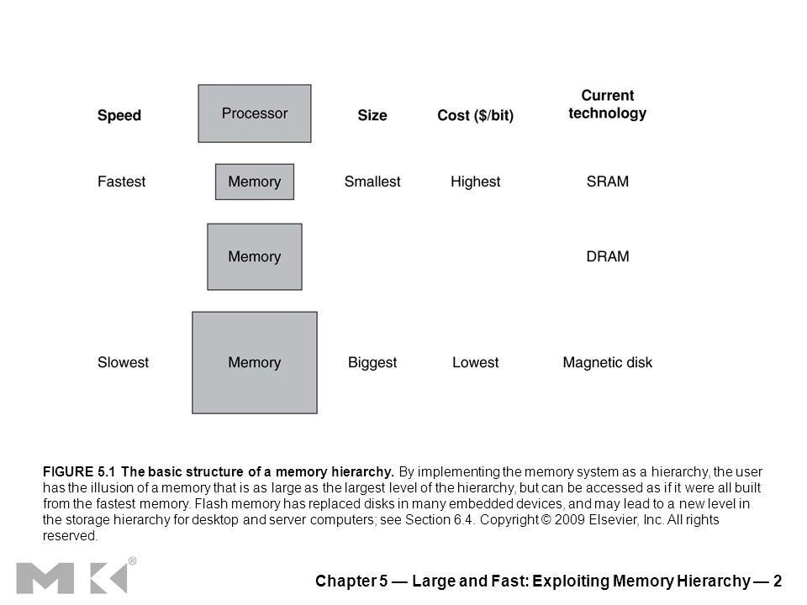
Memory hierarchy
A structure that uses multiple levels of memories
As the distance from the processor increases, the size of the memories and the access time both increase
If the requested data by the processor appears in some block in the upper level
then, the request is called a hit
analogous to your finding the information in one of the books on your desk
If the requested data is not found in the upper level
then the request is called a miss
The next lower level in the hierarchy is then accessed to retrieve the block containing the requested data
Continuing our analogy, you go from your desk to the shelves to find the desired book
The hit rate, or hit ratio, is the fraction of memory accesses found in the upper level
often used as a measure of the performance of the memory hierarchy
The miss rate (1 − hit rate)
the fraction of memory accesses not found in the upper level

Slide 4
Memory Hierarchy
Which of the following statements are generally true?
1. Memory hierarchies take advantage of temporal locality.
2. On a read, the value returned depends on which blocks are in the cache
3. Most of the cost of the memory hierarchy is at the highest level.
4. Most of the capacity of the memory hierarchy is at the lowest level

Slide 5
Memory Hierarchy
Which of the following statements are generally true?
1. Memory hierarchies take advantage of temporal locality.
2. On a read, the value returned depends on which blocks are in the cache.
3. Most of the cost of the memory hierarchy is at the highest level.
4. Most of the capacity of the memory hierarchy is at the lowest level
Which of the following statements are generally true?
1. Memory hierarchies take advantage of temporal locality.
2. On a read, the value returned depends on which blocks are in the cache.
3. Most of the cost of the memory hierarchy is at the highest level.
4. Most of the capacity of the memory hierarchy is at the lowest level

Slide 6
Principle of locality
Principle of locality
programs access a relatively small portion of their address space at any instant of time, just as you accessed a very small portion of the library’s collection
Two different types of locality
Temporal locality (locality in time):
if an item is referenced, the same item will tend to be referenced again soon
Spatial locality (locality in space):
if an item is referenced, then the items whose addresses are close by will tend to be referenced soon

Slide 7
Memory Technologies
Main memory
implemented from DRAM (dynamic random access memory),
The levels closer to the processor (caches)
use SRAM (static random access memory)
The third technology is flash memory
This nonvolatile memory is the secondary memory in Personal Mobile Devices
The fourth technology is magnetic disk
used to implement the largest and slowest level in the hierarchy in servers

Slide 8
Properties of Memory Access
The hit rate, or hit ratio,
the fraction of memory accesses found in the upper level;
it is often used as a measure of the performance of the memory hierarchy.
The miss rate (1−hit rate)
the fraction of memory accesses not found in the upper level.
Hit time
the time to access the upper level of the memory hierarchy,
the time needed to determine whether the access is a hit or a miss (that is, the time needed to look through the books on the desk)
Miss penalty
the time to replace a block in the upper level with the corresponding block from the lower level, plus the time to deliver this block to the processor

Slide 9
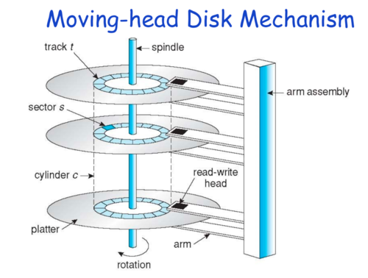
Secondary Memory
To access data,
the operating system must direct the disk through a three-stage process.
The first step
position the head over the proper track
This operation is called a seek, and the time to move the head to the desired track is called the seek time

Slide 10
Timing in secondary memory
Second step
wait for the desired sector to rotate under the read/write head
This time is called the rotational latency or rotational delay
The average latency to the desired information is
halfway around the disk
Disks rotate at 5400 RPM to 15,000 RPM
The average rotational latency at 5400 RPM is
5.6 ms
Third step of a disk access,
transfer time -- the time to transfer a block of bits
The transfer time is a function of the sector size, the rotation speed, and the recording density of a track
Transfer rates in 2012 were between 100 and 200 MB/sec

Slide 11
The Basics of Caches

Slide 12
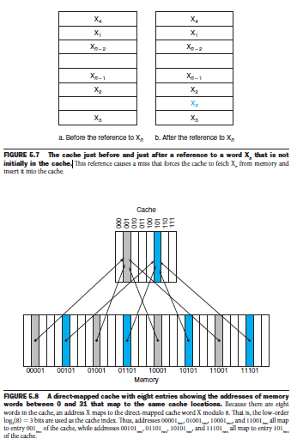
Cache Memory
Cache
the name chosen to represent the level of the memory hierarchy between the processor and main memory in the first commercial computer to have this extra level
Takes advantage of locality of access
Before the request,
the cache contains a collection of recent references X₁, X₂, …, X_{n-1},
the processor requests a word X_{n} that is not in the cache
This request results in a miss,
and the word X_{n} is brought from memory into the cache

Slide 13
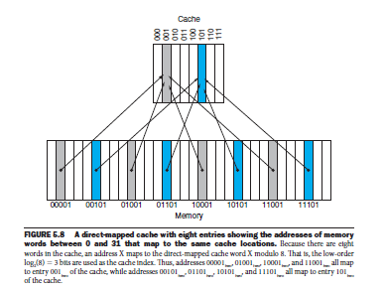
How to access Cache memory?
How do we know if a data item is in the cache?
Moreover, if it is, how do we find it?
The answers are related.
The simplest way to assign a location in the cache for each word in memory is to assign the cache location based on the address of the word in memory.
This cache structure is called direct mapped, since each memory location is mapped directly to exactly one location in the cache.
Cache address = (Block address) modulo (Number of blocks in the cache)
An 8-block cache uses the three lowest bits (8 =2^3) of the block address

Slide 14
Direct access cache
Because each cache location can contain the contents of a number of different memory locations,
how do we know whether the data in the cache corresponds to a requested word?
We answer this question by adding a set of tags to the cache.
The tags contain the address information required to identify whether a word in the cache corresponds to the requested word
The tag needs only to contain the upper portion of the address, corresponding to the bits that are not used as an index into the cache
When a processor starts up,
the cache does not have good data, and the tag fields will be meaningless
a valid bit is used to indicate whether an entry contains a valid address

Slide 15
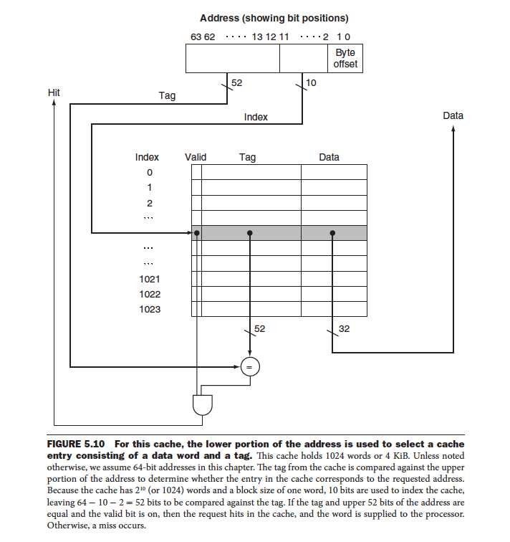

Slide 16
Cache size
How many total bits are required for a direct-mapped cache with 16 KiB of data and 4-word blocks, assuming a 32-bit address?
Ans.
16 KiB = 4096 (2¹²) words
With a block size of 4 words (2²), there are 1024 (2¹⁰) blocks
Each block has 4 x 32 or 128 bits of data + a tag (32 - 10 - 2 - 2 = 18 bits) + a valid bit
Thus, the total cache size is 2¹⁰ x (4 x 32 + (32 - 10 - 2 - 2) + 1) = 2¹⁰ x 147 = 147 Kibits
For this cache, the total number of bits in the cache is about 1.15 times as many as needed just for the storage of the data.

Slide 17
Accessing a Cache
Below is a sequence of nine memory references to an empty eight-block cache, including the action for each reference.
Decimal address of reference | Binary address of reference | Hit or miss in cache | Assigned cache block (where found or placed) | Tag
22 | 10110two | miss | (10110two mod 8) = 110two | 10two

Slide 18
Accessing a Cache
Below is a sequence of nine memory references to an empty eight-block cache, including the action for each reference.
Decimal address of reference | Binary address of reference | Hit or miss in cache | Assigned cache block (where found or placed) | Tag
22 | 10110two | miss | (10110two mod 8) = 110two | 10two
26 | 11010two | miss | (11010two mod 8) = 010two | 11two

Slide 19
Accessing a Cache
Below is a sequence of nine memory references to an empty eight-block cache, including the action for each reference.
Decimal address of reference | Binary address of reference | Hit or miss in cache | Assigned cache block (where found or placed) | Tag
22 | 10110two | miss | (10110two mod 8) = 110two | 10two
26 | 11010two | miss | (11010two mod 8) = 010two | 11two
22 | 10110two | hit | (10110two mod 8) = 110two | 10two

Slide 20
Accessing a Cache
Below is a sequence of nine memory references to an empty eight-block cache, including the action for each reference.
Decimal address of reference | Binary address of reference | Hit or miss in cache | Assigned cache block (where found or placed) | Tag
22 | 10110two | miss | (10110two mod 8) = 110two | 10two
26 | 11010two | miss | (11010two mod 8) = 010two | 11two
22 | 10110two | hit | (10110two mod 8) = 110two | 10two
26 | 11010two | hit | (11010two mod 8) = 010two | 11two

Slide 21
Accessing a Cache
Below is a sequence of nine memory references to an empty eight-block cache, including the action for each reference.
Decimal address of reference | Binary address of reference | Hit or miss in cache | Assigned cache block (where found or placed) | Tag
22 | 10110two | miss | (10110two mod 8) = 110two | 10two
26 | 11010two | miss | (11010two mod 8) = 010two | 11two
22 | 10110two | hit | (10110two mod 8) = 110two | 10two
26 | 11010two | hit | (11010two mod 8) = 010two | 11two
16 | 10000two | miss | (10000two mod 8) = 000two | 10two

Slide 22
Accessing a Cache
Below is a sequence of nine memory references to an empty eight-block cache, including the action for each reference.
Decimal address of reference | Binary address of reference | Hit or miss in cache | Assigned cache block (where found or placed) | Tag
22 | 10110two | miss | (10110two mod 8) = 110two | 10two
26 | 11010two | miss | (11010two mod 8) = 010two | 11two
22 | 10110two | hit | (10110two mod 8) = 110two | 10two
26 | 11010two | hit | (11010two mod 8) = 010two | 11two
16 | 10000two | miss | (10000two mod 8) = 000two | 10two
3 | 00011two | miss | (00011two mod 8) = 011two | 00two

Slide 23
Accessing a Cache
Below is a sequence of nine memory references to an empty eight-block cache, including the action for each reference.
Decimal address of reference | Binary address of reference | Hit or miss in cache | Assigned cache block (where found or placed) | Tag
22 | 10110two | miss | (10110two mod 8) = 110two | 10two
26 | 11010two | miss | (11010two mod 8) = 010two | 11two
22 | 10110two | hit | (10110two mod 8) = 110two | 10two
26 | 11010two | hit | (11010two mod 8) = 010two | 11two
16 | 10000two | miss | (10000two mod 8) = 000two | 10two
3 | 00011two | miss | (00011two mod 8) = 011two | 00two
16 | 10000two | hit | (10000two mod 8) = 000two | 10two

Slide 24
Accessing a Cache
Below is a sequence of nine memory references to an empty eight-block cache, including the action for each reference.
Decimal address of reference | Binary address of reference | Hit or miss in cache | Assigned cache block (where found or placed) | Tag
22 | 10110two | miss | (10110two mod 8) = 110two | 10two
26 | 11010two | miss | (11010two mod 8) = 010two | 11two
22 | 10110two | hit | (10110two mod 8) = 110two | 10two
26 | 11010two | hit | (11010two mod 8) = 010two | 11two
16 | 10000two | miss | (10000two mod 8) = 000two | 10two
3 | 00011two | miss | (00011two mod 8) = 011two | 00two
16 | 10000two | hit | (10000two mod 8) = 000two | 10two
18 | 10010two | miss | (10010two mod 8) = 010two | 10two

Slide 25
Accessing a Cache
Below is a sequence of nine memory references to an empty eight-block cache, including the action for each reference.
Decimal address of reference | Binary address of reference | Hit or miss in cache | Assigned cache block (where found or placed) | Tag
22 | 10110two | miss | (10110two mod 8) = 110two | 10two
26 | 11010two | miss | (11010two mod 8) = 010two | 11two
22 | 10110two | hit | (10110two mod 8) = 110two | 10two
26 | 11010two | hit | (11010two mod 8) = 010two | 11two
16 | 10000two | miss | (10000two mod 8) = 000two | 10two
3 | 00011two | miss | (00011two mod 8) = 011two | 00two
16 | 10000two | hit | (10000two mod 8) = 000two | 10two
18 | 10010two | miss | (10010two mod 8) = 010two | 10two
16 | 10000two | hit | (10000two mod 8) = 000two | 10two

Slide 26
Cache size estimation
For the following situation:
32-bit addresses
A direct-mapped cache, with 2^{n} blocks → n bits are used for the block index
The block size is 2^{m} words (2^{m+2} bytes) → m bits for a word within the block, and two bits for a byte in a word
The size of the tag field is 32 - (n + m + 2)
The total number of bits in a direct-mapped cache is
(2^{n} x block size) + (2^{n} x tag size) + (2^{n} x valid field size)
Since the block size is 2^{m} words (2^{m+5} bits), and 1 bit for the valid field, the number of bits in such a cache is
2^{n} x (2^{m} x 32 - (32 - n - m - 2) + 1) = 2^{n} x (2^{m} x 32 + 31 - n - m)

Slide 27
Bits in a Cache: Example
How many total bits are required for a direct-mapped cache with 16 KiB of data and 4-word blocks, assuming a 32-bit address?

Slide 28
Bits in a Cache: Example
How many total bits are required for a direct-mapped cache with 16 KiB of data and 4-word blocks, assuming a 32-bit address?
Ans.
We have 16 KiB = 4096 (2¹²) words
With a block size of 4 words (2²), there are 1024 (2¹⁰) blocks
Each block has
4 x 32 = 128 bits of data
a tag (tag size = 32 - 10 - 2 - 2 bits)
a valid bit
Thus, the total cache size is 2¹⁰ x (4 x 32 + (32 – 10 – 2 – 2) + 1) = 2¹⁰ x 147 = 147 Kibibits or 18.4 KiB for a 16 KiB cache
For this cache, the total number of bits in the cache is about 1.15 times as many as needed just for the storage of the data

Slide 29
Mapping an Address to a Multiword Cache Block
Consider a cache with 64 blocks and a block size of 16 bytes
To what block number does byte address 1200 map?

Slide 30
Mapping an Address to a Multiword Cache Block
Consider a cache with 64 blocks and a block size of 16 bytes
To what block number does byte address 1200 map?
Ans.
block = (Block address) modulo (#blocks in the cache), where the block address = (Byte address) /(Bytes per block)
Notice that this block address is the block containing all addresses between
(Byte address/ Bytes per block) x Bytes per block and
(Byte address / Bytes per block) x Bytes per block + (Bytes per block - 1)
Thus, with 16 bytes per block,
Byte address 1200 → the block address = 1200/ 16 = 75
And, block address 75 → the cache block number = (75 modulo 64) = 11
In fact, this block maps all byte addresses between 1200 and 1215

Slide 31
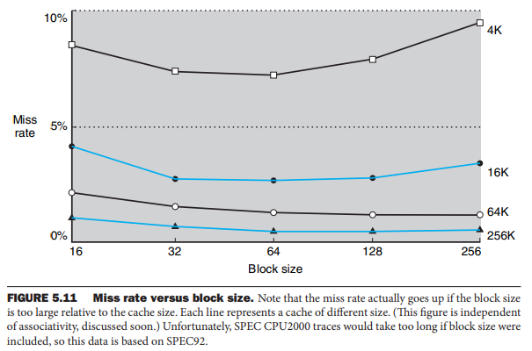
Trade off with block size
Larger blocks exploit spatial locality to lower miss rates
A more serious problem associated with just increasing the block size is that the cost of a miss increases
The miss penalty is determined by the time required to fetch the block from the next lower level of the hierarchy and load it into the cache
The time to fetch the block has two parts: the latency to the first word and the transfer time for the rest of the block.

Slide 32
Handling Cache Misses
How the control unit deals with cache misses?
Cache miss:
A request for data from the cache that cannot be filled because the data is not present in the cache
The control unit must
detect a miss and
process the miss by fetching the requested data from memory
The cache miss handling is done in collaboration with the processor control unit and with a separate controller that initiates the memory access and refills the cache
Out-of-order processors can allow execution of instructions while waiting for a cache miss,
but we’ll assume in-order processors that stall on cache misses
how instruction misses are handled?
These techniques can be extended to handle cache miss

Slide 33
Handling Cache Misses
If an instruction access results in a miss,
then the content of the Instruction register is invalid
To get the proper instruction into the cache,
we must be able to instruct the lower level in the memory hierarchy to perform a read
Since the program counter is incremented in the first clock cycle of execution,
the address of the instruction that generates an instruction cache miss is equal to PC - 4
Once we have the address,
we need to instruct the main memory to perform a read
We wait for the memory to respond (it will take multiple clock cycles),
Then write the words containing the desired instruction into the cache
The control of the cache on a data access is essentially identical

Slide 34
Handling Writes: write-through and write buffer
the cache and memory are said to be inconsistent
If the value of a same variable is different in the cache and the memory
The simplest solution is write-through
write the data into both the memory and the cache
What about performance using write-through?
Example: suppose 10% of the instructions are stores
If the CPI without cache miss was 1.0, then a spending of 100 extra cycles on every write would lead to a CPI of 1.0 + 100 x 10% = 11,
So, performance is reduced by more than a factor of 10
What is the solution?
use a write buffer
A write buffer stores the data while it is waiting to be written to memory
After writing the data into the cache and into the write buffer, the processor can continue execution

Slide 35
Handling Writes
Only if the write buffer is full when the processor reaches a write,
the processor must stall until there is an empty position in the write buffer
Of course,
if the rate at which the memory can complete writes is less than the rate at which the processor is generating writes, no amount of buffering can help
Alternately, The rate at which writes are generated may also be less than the rate at which the memory can accept them, and yet stalls may still occur
This can happen when the writes occur in bursts

Slide 36
Handling Writes: write-back
write-back scheme
when a write occurs, the new value is written only to the block in the cache
The modified block is written to the lower level of the hierarchy when it is replaced
Write-back schemes can improve performance,
especially when processors can generate writes as fast or faster than the writes can be handled by main memory
however, more complex to implement than write-through

Slide 37
Check Point
The speed of the memory system affects the designer’s decision on the size of the cache block
Which of the following cache designer guidelines are generally valid?
1. The shorter the memory latency, the smaller the cache block
2. The shorter the memory latency, the larger the cache block
3. The higher the memory bandwidth, the smaller the cache block
4. The higher the memory bandwidth, the larger the cache block

Slide 38
Check Point
The speed of the memory system affects the designer’s decision on the size of the cache block
Which of the following cache designer guidelines are generally valid?
1. The shorter the memory latency, the smaller the cache block
2. The shorter the memory latency, the larger the cache block
3. The higher the memory bandwidth, the smaller the cache block
4. The higher the memory bandwidth, the larger the cache block

Slide 39
Measuring and Improving Cache Performance

Slide 40
Schemes
Reducing the miss rate by reducing the probability that two different memory blocks will contend for the same cache location
Reducing the miss penalty by adding an additional level to the hierarchy

Slide 41
Checkpoint
Match the definitions in the right column to the terms in the left column.
1. L1 cache a. A cache for a cache
2. L2 cache b. A cache for disks
3. Main memory c. A cache for a main memory
4. TLB d. A cache for page table entries

Slide 42
Checkpoint
Match the definitions in the right column to the terms in the left column.
1. L1 cache a. A cache for a cache
2. L2 cache b. A cache for disks
3. Main memory c. A cache for a main memory
4. TLB d. A cache for page table entries

Slide 43
CPU Time
CPU time can be divided into
the clock cycles that the CPU spends executing the program and
the clock cycles that the CPU spends waiting for the memory system
Normally,
we assume that the costs of cache accesses that are hits are part of the normal CPU execution cycles.
Thus,
CPU time = (CPU execution clock cycles + Memory-stall clock cycles) x Clock cycle time
The memory-stall clock cycles come primarily from cache misses
Memory-stall clock cycles = the sum of the stall cycles coming from reads + those coming from writes
Memory-stall clock cycles = (Read-stall cycles + Write-stall cycles)

Slide 44
Read stall cycles
The read-stall cycles can be defined in terms of
the number of read accesses per program,
the miss penalty in clock cycles for a read, and
the read miss rate:
So,
Read-stall cycles = (Reads / Program) x Read miss rate x Read miss penalty

Slide 45
Write stall cycles
For a write-through scheme,
we have two sources of stalls:
write misses : usually require that we fetch the block before continuing the write
and write buffer stalls: occur when the write buffer is full when a write occurs
Thus, the cycles stalled for writes equals the sum of these two:
Write-stall cycles = (Writes / Program) x Write miss rate x Write miss penalty + Write buffer stalls
Because the write buffer stalls depend on the proximity of writes, and not just the frequency,
it is not possible to give a simple equation to compute such stalls
Hence, often ignored

Slide 46
Write stall cycles
Write-back schemes
Will be discussed later
In most write-through cache organizations,
read miss penalty = write miss penalty
Because the time to fetch the block from memory is same
If we assume that the write buffer stalls are negligible,
we can combine the reads and writes by using a single miss rate and the miss penalty:
Memory-stall clock cycles = (Memory accesses / Program) x Miss rate x Miss penalty
Memory-stall clock cycles = (Instructions / Program) x (Misses / Instruction) x Miss penalty

Slide 47
Check Point
Assume the miss rate of an instruction cache is 2% and the miss rate of the data cache is 4%.
If a processor has a CPI of 2 without any memory stalls and the miss penalty is 100 cycles for all misses,
determine how much faster a processor would run with a perfect cache that never missed
Assume the frequency of all loads and stores is 36%.

Slide 48
Check Point
Assume the miss rate of an instruction cache is 2% and the miss rate of the data cache is 4%.
If a processor has a CPI of 2 without any memory stalls and the miss penalty is 100 cycles for all misses,
determine how much faster a processor would run with a perfect cache that never missed.
Assume the frequency of all loads and stores is 36%.
Ans.
The number of memory miss cycles for instructions in terms of the Instruction count (I) is
Instruction miss cycles = I x 2% x 100 = 2.00 x I
As the frequency of all loads and stores is 36%, we can find the number of memory miss cycles for data references:
Data miss cycles = I x 36% x 4% x 100 = 1.44 x I
The total number of memory-stall cycles is 2.00 I + 1.44 I = 3.44 I
This is more than three cycles of memory stall per instruction.
Accordingly, the total CPI including memory stalls = 2 + 3.44 = 5.44
Since there is no change in instruction count or clock rate, the ratio of the CPU execution times is
(CPU time with stalls / CPU time with perfect cache)
= (I x CPI_{stall} x Clock cycle) / (I x CPI_{perfect} x Clock cycle)
= (CPI_{stall} / CPI_{perfect}) = 5.44 / 2
The performance with the perfect cache is better by 5.44 /2 = 2.72

Slide 49
Check Point
What happens if the processor is made faster, but the memory system is not?

Slide 50
Check Point
What happens if the processor is made faster, but the memory system is not?
Ans.
The amount of time spent on memory stalls will take up an increasing fraction of the execution time
Suppose we speed-up the computer in the previous example by reducing its CPI from 2 to 1 without changing the clock rate
which might be done with an improved pipeline
The system with cache misses would then have a CPI of 1 + 3.44 = 4.44, and the system with the perfect cache would be 4.44 /1 = 4.44 times as fast.
The amount of execution time spent on memory stalls would have risen from 3.44/5 44 = 63% to 3.44/ 4 44 = 77%

Slide 51
Check Point
What happens if the processor is made faster, but the memory system is not?
Ans.
The amount of time spent on memory stalls will take up an increasing fraction of the execution time
Similarly, increasing the clock rate without changing the memory system also increases the performance lost due to cache misses

Slide 52
average memory access time (AMAT)
to examine alternative cache designs
AMAT = Time for a hit + Miss rate x Miss penalty

Slide 53
Check Point
Find the AMAT for a processor with a 1 ns clock cycle time, a miss penalty of 20 clock cycles, a miss rate of 0.05 misses per instruction, and a cache access time (including hit detection) of 1 clock cycle.
Assume that the read and write miss penalties are the same and ignore other write stalls.
The average memory access time per instruction is AMAT Time for a hit Miss rate Miss penalty 1 0.05 20 2 clock cycles or 2 ns.

Slide 54


